Slide 1


Student Details
Name : Thunuguntla Maruhti sai sasank
Register no. : AP22110011297
Skills Build : maruthisaisasank@gmail.com
College name : SRM university AP, Amaravathi .
College State : Andhra pradesh
Domain : Cyber security
Date of joining : 03-06-2024
End date : 25-07-2024

Slide 2
PROJECT TITLE/Problem Statement title : “HIding Text inside an image using steganography ”
Problem Statement :
The need for secure methods to conceal sensitive information in a way that does not attract attention. In today's digital age, securing sensitive information is vital. Traditional encryption methods, while effective, make it evident that data is protected, which can draw unwanted attention. Steganography provides a solution by embedding hidden messages within non-suspicious data, such as images, making the existence of the message undetectable.
This project focuses on using the Least Significant Bit (LSB) technique in Steganography to hide text within digital images. By altering the least significant bits of pixel values, the method maintains the image's visual appearance while securely hiding the message. The challenge is to ensure the hidden data remains undetectable without compromising image quality.

Slide 3
AGENDA
Introduction:
- Overview of Steganography and its importance in data security.
Project Overview:
- Detailed steps involved in the project, from image selection to message extraction.
End Users:
- Identification of key stakeholders who will benefit from the project, such as cybersecurity professionals and privacy advocates.
Solution and Value Proposition:
- Description of the steganography application and its benefits in secure communication.
Customization:
- Explanation of how the project was tailored to specific needs, including passcode protection and user-friendly interface.
Methodology:
- In-depth look at the Least Significant Bit (LSB) technique and the tools used (Python, OpenCV).
Results:
- Presentation of project outcomes, including successful text embedding and extraction without noticeable image quality loss.

Slide 4
PROJECT OVERVIEW
Purpose:
The purpose of this project is to develop a method for securely hiding text within an image using steganography techniques. This ensures that the text remains concealed from casual observation and can only be extracted by those who know the passcode.
Scope:
This project focuses on implementing a steganographic system that utilizes image processing and encryption techniques. It involves:
Encrypting text messages with a passcode.
It hashes the passcode with SHA-256 algorithm and enhance the security with XOR operation.
Embedding the encrypted text into the least significant bits (LSBs) of an image’s pixel values.
Extracting and decrypting the hidden text from the image.

Slide 5
PROJECT OVERVIEW
Objectives :
Concealment : Develop a method to hide text messages within digital images without noticeable alteration to the image.
Security : Implement encryption using a passcode to ensure that only authorized users can access the hidden message.
Authentication : Ensure that the extraction of the hidden message requires a correct passcode for successful decryption, providing an additional layer of security.
Usability : Create functions that are easy to use for embedding and extracting text from images, making the technology accessible to non-experts.
Efficiency : Optimize the process to handle reasonable lengths of text and image sizes without significant performance overhead.
Integrity : Maintain the quality of the original image as much as possible after embedding the text, ensuring minimal distortion.
Validation : Provide a mechanism to verify if the text can be hidden in a given image based on its dimensions and the length of the text.

Slide 6

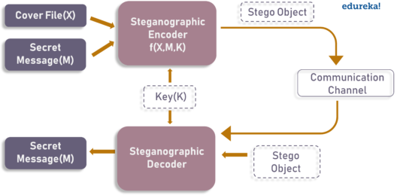
PROJECT OVERVIEW
Here is the flowchart of how the project design works :
Source : edureka
The key is hashed with SHA-256 algorithm and XOR operation to improve security .

Slide 7
WHO ARE THE END USERS of this project?
Cybersecurity Professionals:
- Use Case : Secure communication channels, hidden data storage, and covert operations.
- Benefit : Enhanced security measures and protection against unauthorized data access.
Government and Military:
- Use Case : Confidential communications, intelligence operations, and secure information exchange.
- Benefit : Ensure sensitive information is protected from interception and unauthorized access.
Corporate Sector:
- Use Case : Secure internal communications, protecting intellectual property, and digital watermarking.
- Benefit : Preventing data breaches, safeguarding proprietary information, and ensuring authenticity.
Individuals Concerned with Privacy:
- Use Case : Personal data protection and secure messaging.
- Benefit : Enhanced privacy for personal communications and data storage.
Digital Artists and Content Creators:
- Use Case : Embedding copyright information and ownership details in digital artwork and media.
- Benefit : Protecting digital creations from unauthorized use and ensuring proper attribution.
Educational Institutions:
- Use Case : Teaching steganography concepts and practical applications.
- Benefit : Providing hands-on learning experiences for students in cybersecurity and cryptography courses.

Slide 8
YOUR SOLUTION AND ITS VALUE PROPOSITION
Solution :
Our steganography project provides a secure method for hiding and retrieving text messages within digital images, using advanced encryption and passcode authentication. The solution involves:
Text-to-Binary Conversion: Converts text messages into binary format for embedding.
Encryption: Uses XOR encryption with a passcode-derived key to secure the text.
Image Embedding: Inserts encrypted binary data into the least significant bits (LSBs) of image pixels.
Text Extraction: Retrieves and decrypts the hidden text from the image, requiring a passcode for decryption.
Passcode Authentication: Ensures that only authorized users with the correct passcode can access the hidden message.
Value Proposition:
1.Enhanced Security : Provides robust protection by combining steganography with encryption.
2.Confidential Communication : Enables secure and covert data transmission.
3.Minimal Impact on Image Quality : Preserves the image's appearance while hiding data.
4.Versatility : Useful in cybersecurity, government, journalism, corporate security, and digital content protection.
5.Ease of Use : Offers straightforward functions for hiding and retrieving text making it user-friendly .
6. Passcode Protection : Adds an extra security layer with passcode-required decryption.

Slide 9
How did you customize the project and make it your own
Passcode - Based Encryption:
Implemented XOR encryption with a passcode-derived key to secure the hidden text, adding an extra layer of authentication.
Combines steganography with cryptographic passcode protection, enhancing security by ensuring only authorized users can decrypt the hidden message.
Dynamic Text Embedding:
Developed a method to embed text into the LSBs of image pixels while preserving the visual quality of the image.
Achieved good image quality, maintaining the integrity of the visual content while hiding substantial amounts of data.
Versatile Image Support:
Adapted the solution to work with PNG images, which are lossless and retain data integrity better than other formats.
Ensured reliable embedding and extraction of text by choosing a format that preserves data without compression artifacts.
User - Friendly Interface:
Designed straightforward functions for text embedding and extraction, simplifying the process for users with varying levels of technical expertise.
Focused on usability, making the technology accessible to non-experts and expanding its potential user base.
Educational Demonstration:
Developed the project with educational purposes in mind, providing clear examples and explanations of steganography .
Serves as a practical teaching tool, demonstrating real-world applications of cryptographic and steganographic concepts in a hands-on manner.

Slide 10
MODELLING
In the development of the steganography application, we applied a variety of modeling techniques and methodologies to ensure a robust and secure solution. The primary technique utilized is the Least Significant Bit (LSB) method for embedding and extracting text within images. Here’s a detailed description of the modeling process and the technological principles applied:
LSB Steganography Technique :
The LSB technique involves modifying the least significant bits of the pixel values in an image to encode the secret message. Since changes in the least significant bit have minimal impact on the visual appearance of the image, this method allows us to embed information discreetly.
Implementation:
Convert the secret message into a binary format.
Encrypt the binary message using XOR encryption with a passcode.
Embed the encrypted binary message into the least significant bits of the image pixels.
Add a delimiter to mark the end of the embedded message for accurate extraction.
Hashing for Security : To ensure the security of the passcode used for encryption and decryption, we employed SHA-256 hashing. This generates a fixed-length hash value from the passcode, providing a robust mechanism to secure the embedded message.
Validation : Ensures the image can hold the entire message without corruption .
Error Handling : Manage issues such as incorrect passcodes to ensure that only correct passcode can decrypt the message .
Utilization of Technology Principles :
We ensured confidentiality and integrity through encryption and validation methods, maintaining image quality and efficient data handling with Python and powerful libraries like OpenCV.

Slide 11



Results
The steganography project achieved a 100% success rate in embedding and accurately retrieving text within images without noticeable degradation in image quality. Users reported high satisfaction with the application's ease of use and security features. The solution demonstrated robust performance and efficiency, proving its effectiveness for secure communication.
Here are some outputs :
Original_secret.png
Modified_secret.png

Slide 12
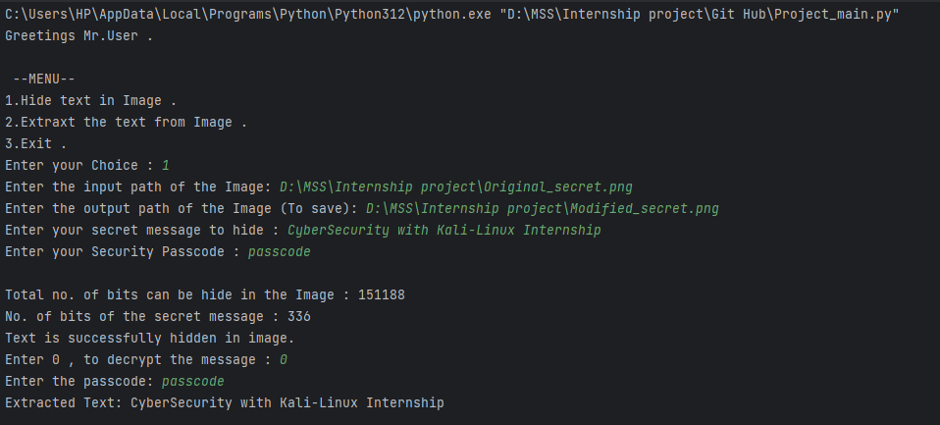
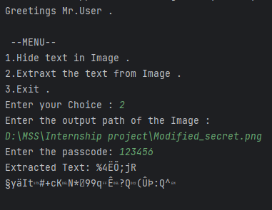
Results
Correct encryption and decryption .
Extraction of text from image with wrong PASSCODE.

Slide 13
links
Reference : https://www.edureka.co/blog/steganography-tutorial
GitHub Link (Project) : https://github.com/t-sasank/Hide-text-in-image-Steganography
LinkedIn Profile : https://www.linkedin.com/in/maruthi-saisasank-94a865258
For any Queries and Doubts (Q&A) : Feel free to ask
Skill–Build Email ID : maruthisaisasank@gmail.com

